Slide 1
CSS3 Cascading Style Sheets
Adding Style to your Pages

Slide 2
Advanced Selectors

Slide 3
Styling Specific Objects
We have focused on type selectors.
What if you don’t want to style all of the links, just some? Or just some of the lists?
CSS gives you options

Slide 4
CSS Selectors
Some selectors follow the DOM
Descendant selectors (nav a)
Style all of the anchor links inside a nav tag
Child selectors (nav > a)
more constraining The anchor elements must be a child of the nav, no intermediate tags, e.g. paragraph
Adjacent sibling (h1 + o)
elements must be at same level and follow each other

Slide 5
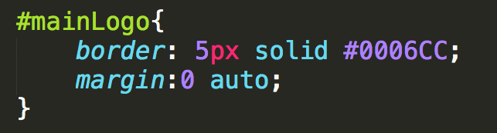
id Selectors
# id selector
Used to identify a single element in the DOM.
Was used extensively for <div id = “header”>, <div id=“footer”>, etc.
There is a small movement to move the use of id OUT of CSS

Slide 6
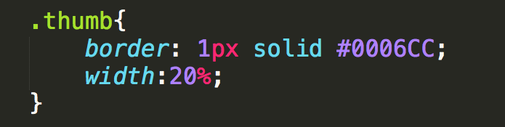
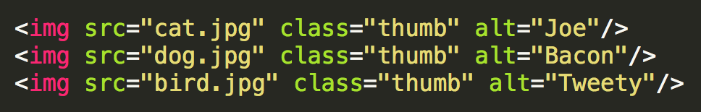
class Selector
. class selector
Used to identify an element in the DOM that is part of a special class of items
Think of thumbnail images, all of the links that are in the navigation, your social media images, etc….

Slide 7
classes vs. ids
Syntax is “.” and “#”
classes can be used multiple times
id should be unique
ids take precedence over classes in styling (see more later)

Slide 8
Narrowing the Scope
As you get more advanced pages, you will want to narrow the scope of the of action
p.main → paragraphs using main class
header img.special → paragraphs inside header that use special class

Slide 9
Expanding the scope
You can combine elements with a comma
p, h1, #main, .special{…rules to apply to all of them…}

Slide 10
More Attribute Selectors
Universal
* applies styling to every element on the page
Ackk!! Try this!
Attribute Selectors
a[href=‘info.html’]
PseudoClasses
Pseudo Elements

Slide 11
Attribute selectors
You may want to search the DOM for certain elements that have an attribute you are looking for
All the images that use gif files…..
All of the images that have empty alt text….
All of the links that go to government sites….

Slide 12
Using Operators
Operators can be used to find those attribute values you are looking for
^ : match the beginning exactly
a [href^=‘http://umich’]
$ : match the end exactly
img[src$ = ‘.png’] → apply to .png images
* : wildcard
a [href*=‘umich’]

Slide 13
Example
Examples:
AdvancedSelectors.html
AdvancedSelectors2.html

Slide 14
Rule Specificity
Each rule has a weight made up of four digits. Calculate using this formula
For each element and pseudo-element – add 1
For each attribute, class or pseudo-class - add 10
For each id - add 100
If the style attribute is used – add 1000.

Slide 15
Specificity example (https://www.w3schools.com/css/css_specificity.asp)
h1 { }
#content h1 { }
.intro {}
<div id="content"><h1 style="color: #ffffff">Heading</h1></div>

Slide 16
Whew!!!
We have actually covered a lot in this short video
Know that each of these ideas can merge. One element can have many classes and ids associated with it
Browser “starts at the top” and applies each rule, sometimes overriding earlier rules.

Slide 17
The Good News
You can use style sheets from others to style your code, just by adding class!!
You can override style sheets from others just by rewriting the class, or making your own version of it and linking it last.

Slide 18
Review
Type selectors can be combined to narrow the scope of where rules are applied
An id is used to specify a specific element in a page
Classes can be used to associate elements that should treated in a similar manner
Notes:
http://codepen.io/shayhowe/pen/FrCHn

Slide 19
Styling Links and Lists

Slide 20

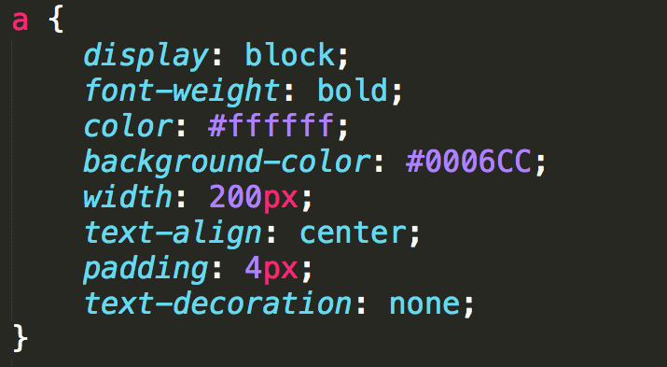

Anchor Links
Links can take on all of the usual styles as well as text-decoration

Slide 21


“Buttons”
Many designers try to make their links look like buttons.
Be semantic, if you want a button use the <button> element instead.

Slide 22
States
Some links are blue, some are purple, etc. Why???
a:link: a normal, unvisited link
a:visited: has been visited
a:hover: activated by mouse (touchscreens….?)
a:focus: activated with the keyboard
a:active: is being clicked

Slide 23
Precedence of Rules
a:hover MUST come after a:link
a:visited and a:active MUST come after a:hover

Slide 24
Styling Lists
Number of properties beyond font, margin, etc.
list-style-type
list-style-image
list-style-position
list-style

Slide 25
Example
Examples:
lists.html
links.html

Slide 26

Pseudo-Classes
Elements that are dynamically populated or dependent on tree structure
You have seen this before…

Slide 27
Types of Pseudo-Classes
Link
:link, :visited
User Action
:hover, :active, :focus
Forms (interfaces)
:enabled, :checked, :disabled

Slide 28
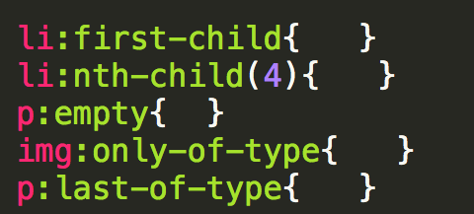
Types of Pseudo-Classes
Structural/Positional
:first-child, :last-child, :nth-child(), :only-child
:first-of-type, :last-of-type, :only-of-type

Slide 29
Pseudo-Elements
These elements aren’t part of the DOM
Can be used to style specific (unique) parts of the page

Slide 30
Types of Pseudo-Elements
Textual
:first-letter, :first-line
Positional/Generated
:before, :after
Fragments
::selection

Slide 31
Review
Embrace the many tools that are available to help you design your site.
Inspect element
http://chrispederick.com/work/web-developer/
http://css3generator.com/

Slide 32
Colors
Using the best colors for your site

Slide 33
Color Conventions
Color names (blue, red, yellow, etc.) work, but should be avoided
Hexadecimal is common convention
#0000FF, #FF0000, #FFFF00
rgb
(0, 0, 1), (1, 0, 0), (1, 1, 0)
rgba
(0, 0, 1, .5)
#0000FF
#FF0000
#FFFF00
rgb(0,0,1)
rgba(0, 0, 1, .5)

Slide 34
Accessibility
Appropriate use of color is critical to web accessibility
Many more people are visually impaired or color blind than are legally blind

Slide 35
What is color contrast?
You intuitively know when something has poor contrast
There are tools that quantify the contrast between text and its background
http://wave.webaim.org/
http://webaim.org/resources/contrastchecker/

Slide 36
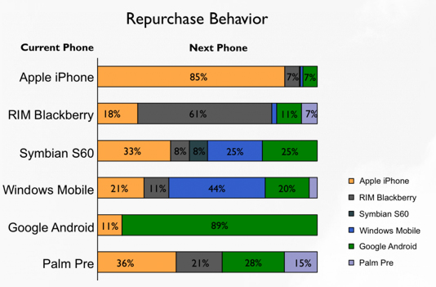
Don’t use color alone to convey meaning

Slide 37
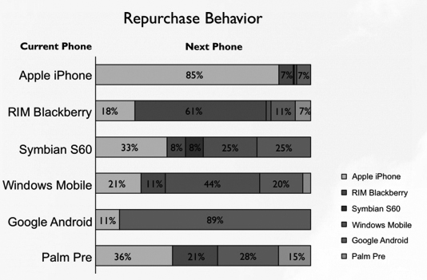
Test in gray scale …

Slide 38
Review
Use web safe colors and use an accepted convention
Test your site using a contrast checker
Avoid using color to convey meaning

Slide 39
Styling Your Text
Styling your text

Slide 40
Options
Many options for styling your text:
font (family, style, variant, size)
color and background
alignment
line-height

Slide 41
font-family
Font families are styles of text
Examples:
Helvetica, Courier, “Courier New”, “Comic Sans MS”, cursive, Verdana

Slide 42
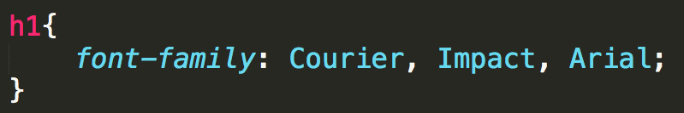
font-family
Not all font-families supported by all of the operating systems, so you can provide alternatives.

Slide 43
Google Fonts
There are almost 1000 additional fonts available through Google fonts
<link href='https://fonts.googleapis.com/css?family=Anton’
rel='stylesheet’>
<style>
body {
font-family: 'Anton';
}
https://www.w3schools.com/howto/howto_google_fonts.asp

Slide 44
font-size
This is only the beginning of our discussion on sizes…
Options
xx-small, x-small, small, smaller
medium
larger, x-large, xx-large, larger
Use pixel
Use %

Slide 45
color and background-color
The color attribute is the color of the foreground.
The background-color is the color of the background

Slide 46
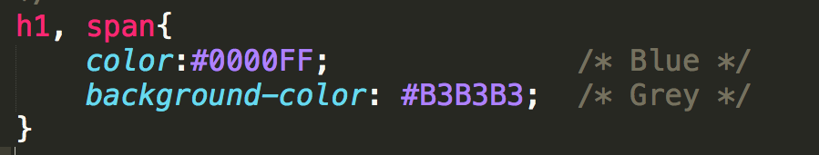
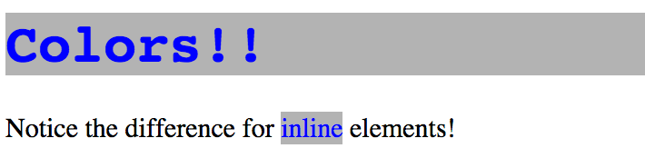
colors
Notes:
h1 is block
span is inline; only takes as much space that it needs

Slide 47
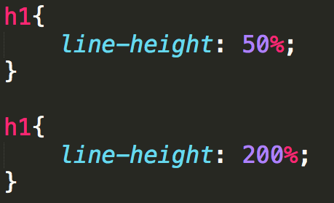
line-height
As you can guess, doesn’t affect font
Adjusts the space between the lines of text

Slide 48
Review
The number of options for styling text can seem overwhelming.
Practice on toy problems!
Design larger projects on paper first!!!
Example – fonts (to view on your own time)

Slide 49
Display and Visibility

Slide 50
Display is Key to Layout
Every element is a box
Display affects the layout of neighboring elements

Slide 51
Common Values
inline: sits next to other elements
takes up “just enough” width and height
block: forces line break
default: take up all horizontal width and “just enough” height
rules can set height and width

Slide 52
Common Values
inline-block:
same as inline, but accepts height and width
none: removed from page
Still in DOM, but not visual (even to SRs)

Slide 53
Examples (Code Pen – Week One)
Display Example
Display Example 2

Slide 54
Complementary Properties
float – USE AS A LAST RESORT
Reposition elements to the right or left.
Elements are aware of one another and will not overlap.
Values: left, right
clear
Used to keep floating elements away
Values: left, right, both

Slide 55
Element Overflow
What happens when you set a height/width and the content doesn’t fit any longer?
Use overflow to determine access

Slide 56
Overflow
visible: Can cause text to show up “on top” of other text
hidden: Hides anything that goes beyond bounding box
This can cause problems since if the user increases font size, they may not be able to see content
scroll: Gives horizontal and vertical scrollbars
auto: Adds scrollbars as needed

Slide 57
Visibility
Specifies whether or not element is visible
Options include:
visible
hidden
collapse (only for table elements)
Unlike display:none a hidden element is still part of the DOM and still takes up space

Slide 58
Review
Display is just one tool for positioning our elements on the page
Early design will make the coding easier
Utilize tools to see the different options

Slide 59
Box Model
Sizing your elements

Slide 60
Height and Width
The default width of inline elements is the content
Elements that are not inline can take width and height properties – we saw this in the Display lecture.

Slide 61
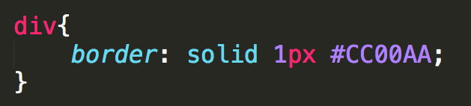
Border
Any element can have a border around it
border property specifies style, width, and color
The border style MUST be specified

Slide 62







Specifying Individual Sides

Slide 63
Margin
Margin is additional space outside your border – between you and neighbor
Positive margin
element moves right/bottom
Negative margin
element moves left/upward

Slide 64
Padding
Padding is additional space between the element and its border.
Positive padding
border moves outward from element
Negative padding
border moves over the element

Slide 65
Margin and Padding
Neither takes a color (transparent)
Can also be defined in 1 - 4 values like border

Slide 66
padding
The empty space between the start of the element and the start of the text
margin
The space between the edge of the screen and the element
Here is my text

Slide 67
Additive Height and Width
Here is my text
Here is my text
margin
+ border
+ padding
+ width
= actual width

Slide 68
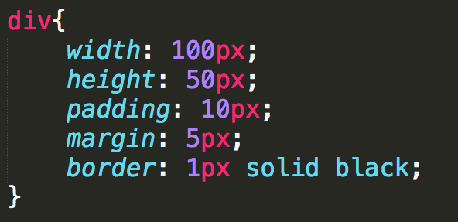
What is the width and height?
width = 132px:
height = 82:

Slide 69
box-sizing
box-sizing takes some of the “math” out
Options:
content-box: default additive
border-box: width takes content, padding, and border into consideration

Slide 70
Measurements
Absolute – set to a specific size
px, mm, cm, pt, ….
Fluid – sets size relative to surrounding elements
%, vw, vh
em (for font): 1em is current size, .75 is 75% of the current size
rem (for font): 1rem is current size of root element

Slide 71
Example
Examples
boxModel.html
Can you
Put these divs next to each other? - Make the screen smaller, still working?
Make them taller?
After you do that, can you now center them under each other?

Slide 72
Review
Design sketches should be done with box model (margin, border, padding, content) in mind.
Use box-model to reduce complexity
Margin must always be considered
Use fluid sizes for best viewing

Slide 73
Centering an Element
To horizontally center an element use:
margin: 0 auto;
But…
The element must display: block
The element must not float
The element must not have a fixed or absolute position
The element must have a width that is not auto

Slide 74
Positioning

Slide 75
Positioning!
Putting elements where you want them can be time-consuming and frustrating
Why not tables?

Slide 76
Position Properties
The four position properties are:
static
relative
absolute
fixed
Position properties are modified by the properties: top, right, bottom, left

Slide 77
Static
Default value for elements
Place in the next available position
Not affected by the top, bottom, left, and right properties.
Notes:
static – put it in the first spot that it fits
block vs inline

Slide 78
Relative
Positioned “relative to itself”
Take the static position, but add offsets.
The new positioning does NOT affect any other element. It is possible to move an element and leave a big hole where it would have been.
Relatively positioned elements are often used as container blocks for absolutely positioned elements.
Notes:
Find the parent and put the exact position requested

Slide 79
Absolute
Element is removed from the document flow and positioned relative to it’s nearest ancestor (or the root)
Other elements behave as if element does not exist
Can end up on top of another element

Slide 80
Fixed Position
Positioned relative to the browser window
Will not move, even if the window is scrolled
IE7 and IE8 support the fixed value only if a !DOCTYPE is specified
Think of popup boxes that wont’ go away!!!
Or a navigation bar that is always visible on the top

Slide 81
Example
positioning.html
Open this page and look at it. The paragraphs are all in their default location. The top/left values are ignored.
Using Inspect Element, uncomment the next line so the position is relative. Each of the paragraphs have moved from their ORIGINAL position
Change the position to absolute. Now they are placed 100 right 100 down from their PARENT
Change the position to fixed. Now they are placed 100 down and 100 right from the BROWSER

Slide 82
Z-index
Multiple elements may be placed in the same position.
z-index is a numeric value, positive or negative that dictates stacking order

Slide 83
Review
Positioning elements is key to achieving desired layouts
Proper planning will make this easier

Slide 84
Transforms

Slide 85
Transforms
Provide option for changing the appearance of elements
Two-dimensional
Three-dimensional

Slide 86
2D Transform Options
Options
translate
rotate
scale
skew
matrix

Slide 87


translate
transform:translate(x, y);
move x pixels to the left/right and y pixel up/down
transform:translate(100, 75);

Slide 88

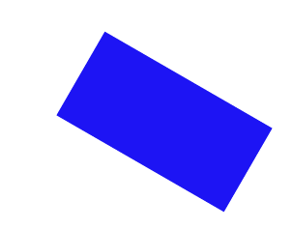
rotate
transform:rotate(deg);
Rotate/”spin” the element a certain number of degrees
transform:rotate(30deg);

Slide 89


scale
transform:scale(width, height);
Change the width and height of the element
transform:scale(2,3);

Slide 90

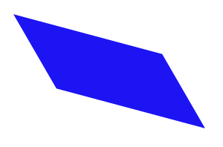
skew
transform:skew(x-angle, y-angle);
Rotate the element a certain number of degrees along the x and y axis
transform:skew(30deg, 15deg)

Slide 91
matrix
matrix() - combines all of the 2D transform methods into one

Slide 92
3D rotate
You can rotate along the x, y, or z dimension along a given degree
transform:rotateY(deg)
transform:rotateX(deg)
transform:rotateZ(deg)
transform:rotate3d(x, y, z)

Slide 93
Others
3D scale
3D translate

Slide 94
Review
Transforms are one more way to modify the look of your page.
Often combined with state changes
Will typically require browser prefixes.

Slide 95
Transitions

Slide 96
Transitions
When elements transition from one state to another, you can alter their appearance
If you hover over the link, change the color
If an image comes into focus, change the size,

Slide 97
The Properties
transition-property
What is it you want to change? (size, color, position, etc.)
transition-duration
How long should each transition last?
transition-timing
Should it be a smooth transition (linear)? Or different?
transition-delay
How long should the wait be before the transition begins?

Slide 98
Setting up
Define your element
Choose the elements for transition
Define the new values
You must combine this step with a pseudo-class

Slide 99
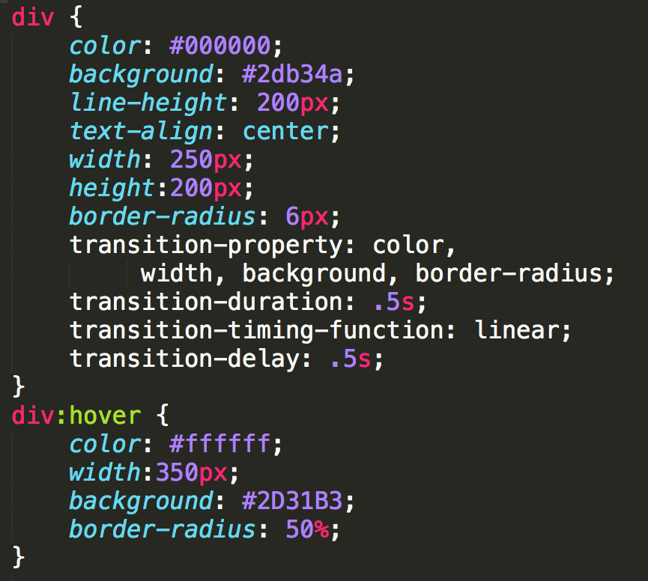
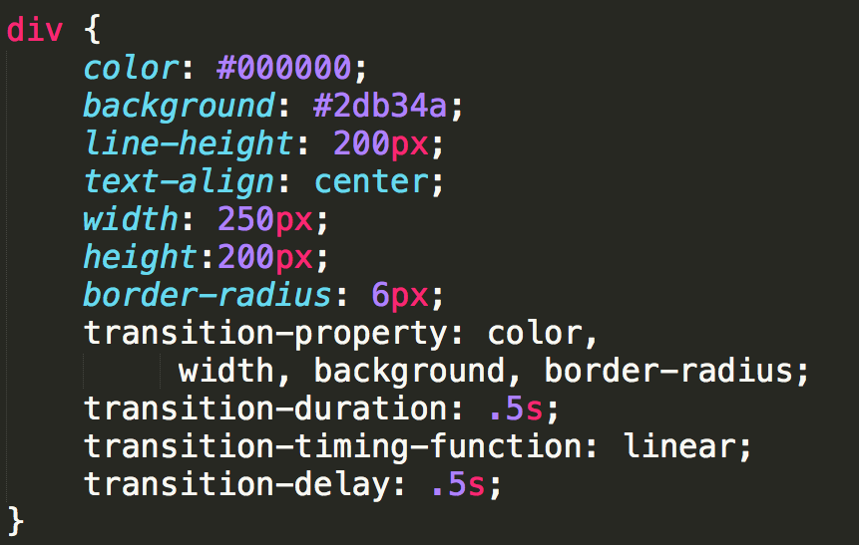
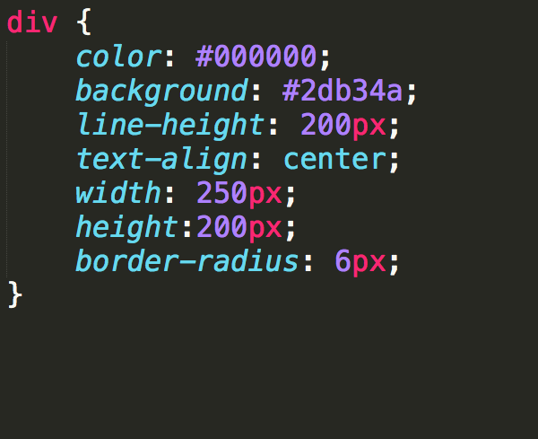
Example (CSS3-transitions)

Slide 100
Using Shorthands
If you have multiple properties transitioning, you can use shorthand:

Slide 101
Browser Capabilities
Designing for consistent appearance

Slide 102
Browsers Differ
Even though browsers are moving to a consistent implementation of HTML, they differ in display and adherence.
It is your responsibility to make sure your page works for a wide audience.

Slide 103
Handling Stylistic Differences
“Easiest” way to eliminate browser differences is to use a default style sheet
Default style sheets reset all of the values for the page
Will make your page look worse!

Slide 104
Handling Unsupported Properties
Not all browsers support all HTML5 tags
Not all browsers support all CSS3 properties
Browser prefixes (or vendor prefixes) provide a quick fix for handling unsupported CSS3 options.

Slide 105
Browser Prefixes
-webkit-: Android, Chrome, iOS, Safari
-moz-: Firefox
-ms-: Internet Explorer
-o-: Opera

Slide 106
Often Unsupported Properties
column-count
border-radius
gradient
Sites such as http://caniuse.com/ will tell you when you need to use prefixes

Slide 107
Automated Ways to include Prefixes
For now, add the prefixes by hand
There are ways to automate the addition of prefixes
Editor add-ons (You have most of the control)
Use outside programs to dynamically add appropriate prefix based on browser

Slide 108
Review
Default style sheets remove stylistic differences
Should default style sheet be internal or external?
Where should it go in relation to other style sheets?
Browser prefixes can help remove some differences caused by unsupported options
Shouldn’t be overused

Slide 109

Acknowledgements/Contributions
These slides are Copyright 2015- Colleen van Lent as part of http://www.intro-webdesign.com/ and made available under a Creative Commons Attribution Non-Commercial 4.0 License. Please maintain this last slide in all copies of the document to comply with the attribution requirements of the license. If you make a change, feel free to add your name and organization to the list of contributors on this page as you republish the materials.
Initial Development: Colleen van Lent , University of Michigan School of Information

